Slide 1
R workshop
The next few days will introduce you to using R and Rstudio to interact with and plot data.
The data we will work with later in the week is related to prediction of the risk of poliovirus in Pakistan.
The next few slides will introduce how this data is used in risk assessments.

Slide 2
Risk factors and short-term projections for serotype-1 poliomyelitis incidence in Pakistan: A spatiotemporal analysis
Molodecky et al. 2017 Plos. Med.

Slide 3
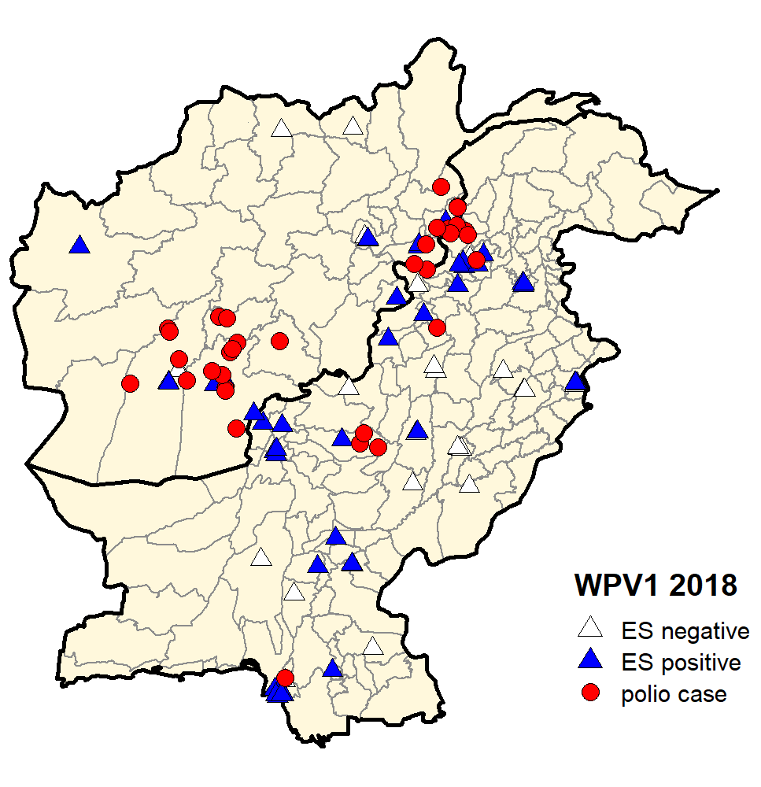
Background
Pakistan and Afghanistan represent the last remaining cluster of wild poliovirus transmission globally. No cases have been seen in Nigeria since 2016
RI and SIAs are the key interventions in Pakistan to interrupt transmission
Accessibility issues are known – estimating risk in inaccessible areas is hard but they also represent risk of transmission to surrounding areas
OPV immunogenicity poorer in Pakistan – multiple doses needed
Targeting interventions important to maximise utility of doses

Slide 4
Global WPV1 Cases, 2009–2019*
Consistent decline in confirmed cases 2014-2017
Updated from presentation by Natalia Molodecky, WHO

Slide 5
Model aim
This work aimed to include movement data in polio risk models to see if polio spread could be better estimated.
Risk models are used to plan SIAs so accuracy is important to the interruption of WPV transmission.

Slide 6
Basic parameters
Vaccination history of AFP cases – reported vaccine doses of non-polio AFP cases divided by number of SIA campaigns in their district between birth and paralysis
RI coverage - % of children receiving 3 RI doses of OPV
Non-polio AFP rate – marker of surveillance intensity
Cases in the same spatial unit
Population and density of each spatial unit – number of individuals important to risk of spread
Population living in poverty
Precipitation
Pop^{n} immunity

Slide 7
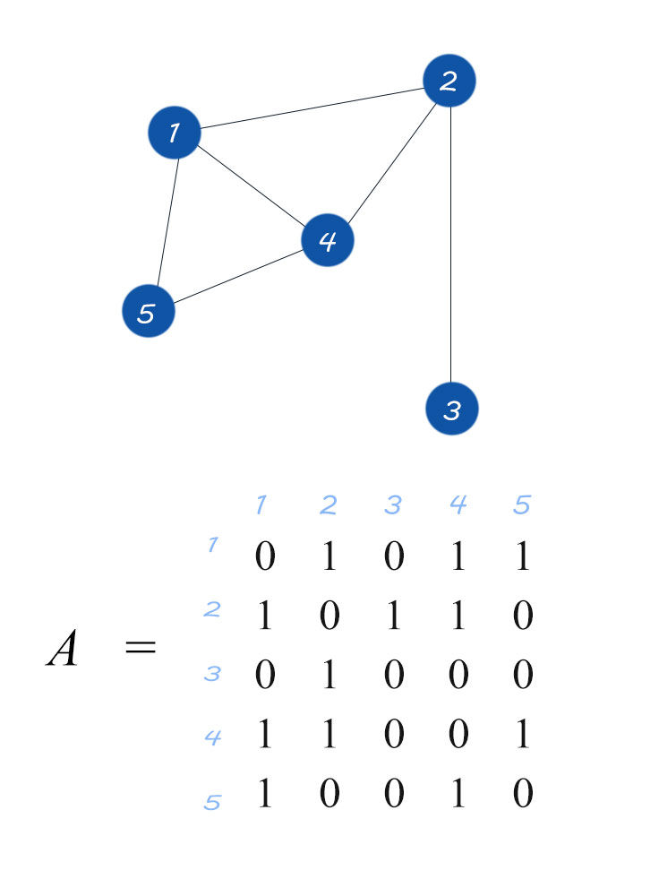
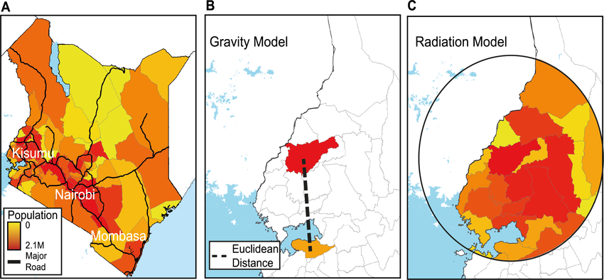
Movement models
First order adjacency
Gravity and radiation models
Wesolowski et al. Plos Comp. Biol. 2015
Notes:
First order adj- any district directly bordering the source district has 1 in the matrix – others have 0
Gravity model – incorporates the 2 districts of interest and their relative populations and the direct straight line distance between them
Radiation model – incorporates the 2 districts of interest and the population of any district within the same straight line distance to the source population
This weights the likelihood of movement between the populations by incorporating the likelihood of movement to any other district with the same travel distance
These are all simple models of population movement – not taking in to account terrain features, road networks, ethnic associations etc.

Slide 8
Movement models
Extensions to these movement models incorporated:
Population density in the radiation model – a small district with high population density is more likely to attract a migrant than a large district with the same population.
Travel time in the radiation model – rather than direct distance we can use road network maps etc to estimate real world travel time.
Mobile phone data in the gravity model – mobile phone data gives an indication of where people are travelling in reality to fit the model to.

Slide 9
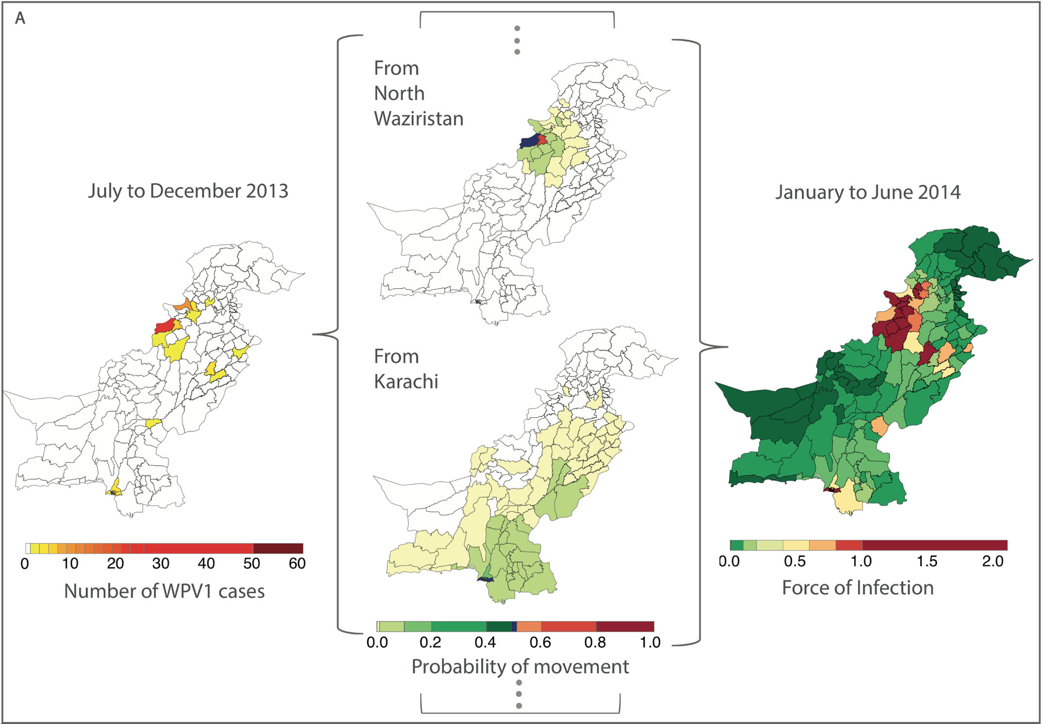
FOI

Slide 10
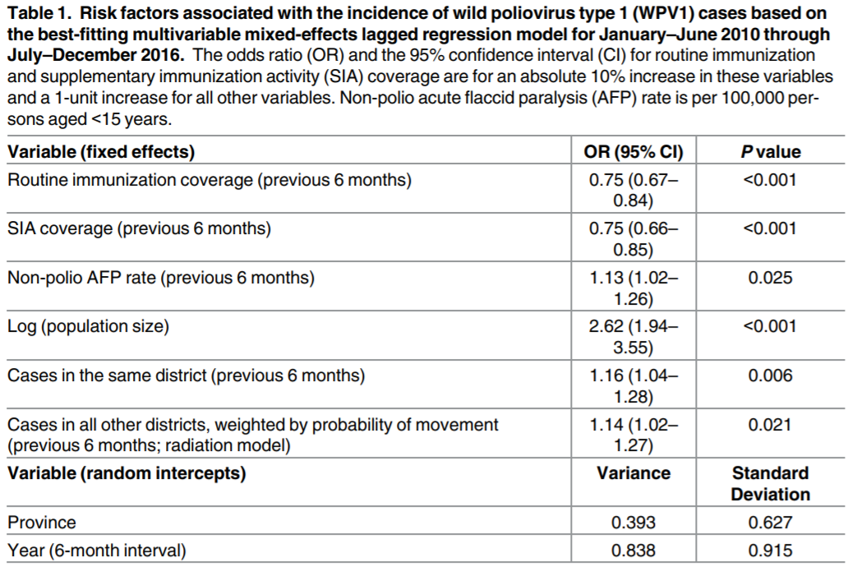
Results
Notes:
For 6 month periods after the start of 2016 out of sample predictions fitted on the previous data were compared to actual reported numbers of cases.
Calculating population immunity from RI and SIA coverage was redundant in the final model and including both individually resulted in better fit

